Slide 1
INTRODUCTION TO PROGRAMMING LANGUAGE II(JAVA)
Fariha Zahin

Slide 2

Reference type vs. Object type
Reference Type
The declared type of a variable.
Determines:
What methods and fields are accessible at compile-time.
Whether the code compiles at all.
Comes from the left side of the assignment:

Slide 3

Object Type
The actual type of the object in memory, created using new
Determines:
What overridden methods run at runtime.
Comes from the right side of the assignment:

Slide 4
Dynamic Dispatch in Java is the process by which a call to an overridden method is resolved at runtime (not at compile time). It happens when a parent class reference variable refers to a child class object, and the method that gets executed depends on the object type, not the reference type.
Key Point:
Variables are resolved at compile time.
Methods (if overridden) are resolved at runtime → this is dynamic dispatch (a.k.a runtime polymorphism).

Slide 5
Operation | Determined By | Notes
Which method gets called (if overridden) | ✅ Object Type (Runtime) | Dynamic dispatch applies
Which method is visible (if not overridden) | ❌ Reference Type (Compile Time) | Compiler checks reference type
Which field is accessed | ❌ Reference Type (Compile Time) | Fields are not polymorphic
Casting allowed? | ✅ Reference Type | You can only call subclass methods/fields after casting

Slide 6
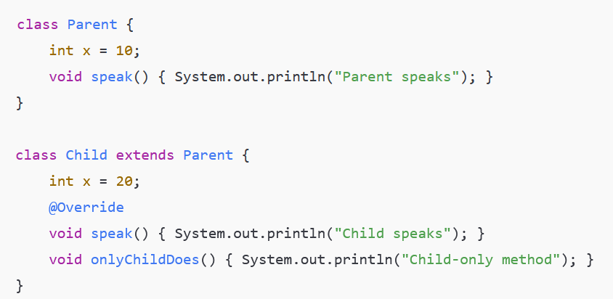
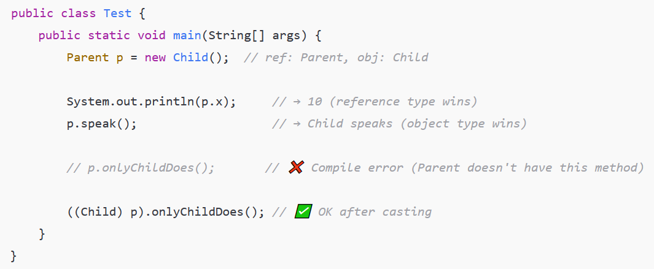

Slide 7
